Slide 1
Nested loops. Arrays

Slide 2
Nested loops
for( ;condition1; ) { statement1; for( ;condition2; ) { statement2; } }
while(condition1) { statement1; while(condition2) { statement2; } }

Slide 3
Nested loops

Slide 4
Arrays

Slide 5
Arrays

Slide 6
Arrays
0
1
2
3
4
5
6
7
8
9

Slide 7
Arrays
0
1
2
3
4
5
6
7
8
9
Indices

Slide 8
Arrays
First index is 0
0
1
2
3
4
5
6
7
8
9
Indices

Slide 9
Arrays
First index is 0
0
1
2
3
4
5
6
7
8
9
Array length is 10
Indices

Slide 10
Arrays
Element/Value
at index 3
First index is 0
0
1
2
3
4
5
6
7
8
9
Array length is 10
Indices

Slide 11
Arrays: Declare, Get and Change
let arr = [10, 20, 30, 40, 50, 60]; let l = arr.length; let element0 = arr[0]; let element4 = arr[3]; arr[1] = 25;

Slide 12
Examples

Slide 13
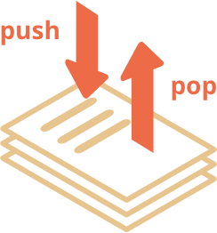
Arrays: Pop and Push
push - adds an element to the end.
pop - takes an element from the end.

Slide 14
Arrays: Pop and Push
let arr = [‘ok’, ‘wow’, ‘hi’, ‘yeah’];
let last = arr.pop();
let newLast = ‘bye’;
arr.push(newLast);

Slide 15
String
Strings can behave them like arrays.
But there are differences!

Slide 16
Loops

Slide 17
Arrays: Loops
let arr = ["Apple", "Orange", "Pear"];
for (let i = 0; i < arr.length; i++) {
alert( arr[i] );
}

Slide 18
Arrays: Loops
let arr = ["Apple", "Orange", "Pear"];
// iterates over array elements
for (let fruit of fruits) {
alert( fruit );
}

